Slide 1
Screening and Enrollment: Women
MTN-016: EMBRACE

Slide 2
Prior to Enrollment
Potential eligibility is assessed through routine pregnancy testing completed during parent protocol study visits
Introduce MTN-016 at first positive pregnancy test
Approach for enrollment in MTN-016 only after protocol definition of ‘known confirmed pregnancy’ is met

Slide 3
Definition: Confirmed Pregnancy
Two consecutive monthly study visits, at least 14 days apart, with positive pregnancy tests, in the absence of signs/symptoms of miscarriage or participant report of pregnancy termination.
One or more of the following assessments:
Auscultation of fetal heart tones
Positive pregnancy test confirmed by clinic staff in the presence of clinically confirmed enlarged uterus
Positive pregnancy test confirmed by clinic staff in the presence of missed menses (no menses occurring at least 60 days from the first day of the last menses) by participant report
Clinical assessment of fetal movement
Demonstration of pregnancy by ultrasound

Slide 4
MTN-016: S&E Visit Procedures
May occur at a regularly scheduled ASPIRE visit or a separately scheduled 016 visit.
Assess/Confirm Eligibility
Informed Consent
MTN-016 PTID Assignment
Demographics
Locator
Medical/Medication History
Pregnancy History
Genetic Screening History
Ultrasound Results
Schedule Next Visit/Reimbursement
As Indicated: Ascertain information on pregnancy outcome
Notes:
Bolded items (animated) will be touched on in this presentation. Others will be covered in SCHARP’s training.
Ultrasound exam may be performed at this visit if the participant is still pregnant or the site can ask for results if an US was recently done (or if the mother is no longer pregnant)?

Slide 5
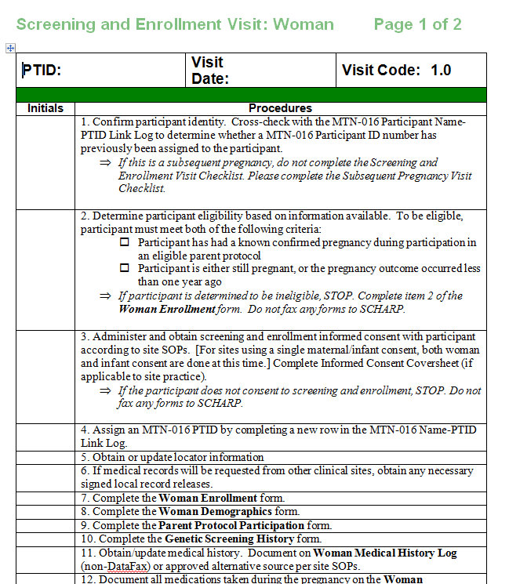
MTN-016: S&E Visit Procedures
Visit checklists, including a screening and enrollment checklist, are available for download and modification on the MTN website.

Slide 6
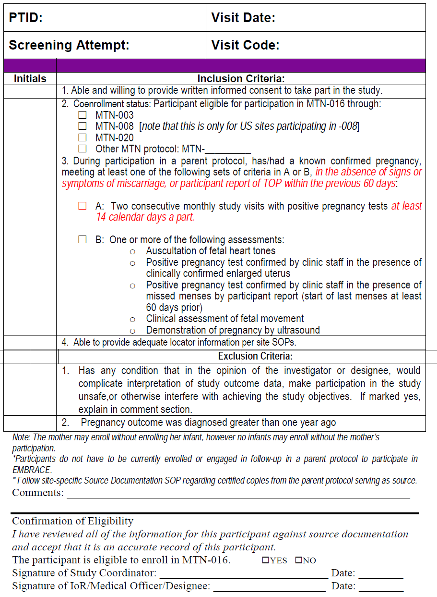
Confirming Eligibility
Eligibility Checklist:
Collect certified copies of source documents from ASPIRE/parent study to demonstrate eligibility and HIV status for CRF completion.
Note that participants DO NOT have to be currently enrolled in ASPIRE to be eligible, as long as they were enrolled in parent protocol during pregnancy
If an eligibility checklist tool is not used, all inclusion/exclusion criteria must be clearly documented in the chart notes.

Slide 7
Adequate Locator
Locator information is also collected in the parent protocol. No need to repeat locator questions during both visits, if done on same day.
Will you keep a central copy of the locator form? Make certified copies? Will any supplemental locator information be required for 016 (defined in site-specific SOPs)? What if the participant has already exited ASPIRE?

Slide 8
Types of Informed Consent in 016
Mother and Infant Screening & Enrollment
May be combined consent or two separate consents
Mothers may enroll without consenting their infants, but infants cannot enroll without the mother being enrolled.
Off-Site Visit ICF
Provides consent for mother or infant visits to occur off-site.
Informed consent for infant HIV testing
ONLY babies of HIV-infected mothers
Comprehension Checklists are required for the Screening & Enrollment and Infant HIV Testing ICFs.
Like ASPIRE, use IC coversheet to document this session.

Slide 9
Screening & Enrollment Logs
MTN-016 Women Screening and Enrollment Log
Site Name and Location:
No. (ex. 1, 2, 3) | Parent Study PTID* (ex. ASPIRE PTID) | Date IC signed (if not signed, specify reason and complete Staff Initials column) | 016 PTID | Eligible? | Subsequent Pregnancy? | Enrollment date (dd MMM yy) | If not enrolled, specify reason | Number of Live Births | Staff initials
 |  |  |  | Y N | Y N
 |  |  |  | Y N | Y N
 |  |  |  | Y N | Y N
 |  |  |  | Y N | Y N
 |  |  |  | Y N | Y N
Notes:
DAIDS SOP for Essential Documents requires study sites to document screening and enrollment activity on screening and enrollment logs. Logs for screening can be maintained separately from logs for enrollment or combined into one log. This is a sample of one pulled from your SSP, section 4, on page 3.

Slide 10
Medical/Medication/Pregnancy History Tips
Medical History CRF documents and tracks all medical conditions experienced by the woman while on-study. This should include conditions that have occurred since the ppt became pregnant, including chronic conditions.
Con Meds Log documents all medication(s) used during the study including any medications taken during pregnancy.
Pregnancy Report and History CRF collects information on current pregnancy (LMP, EDD) and previous pregnancies.
Note: If information from parent protocol is being used to complete 016 CRFs, prepare certified copies of parent study source documents to include in MTN-016 study record

Slide 11
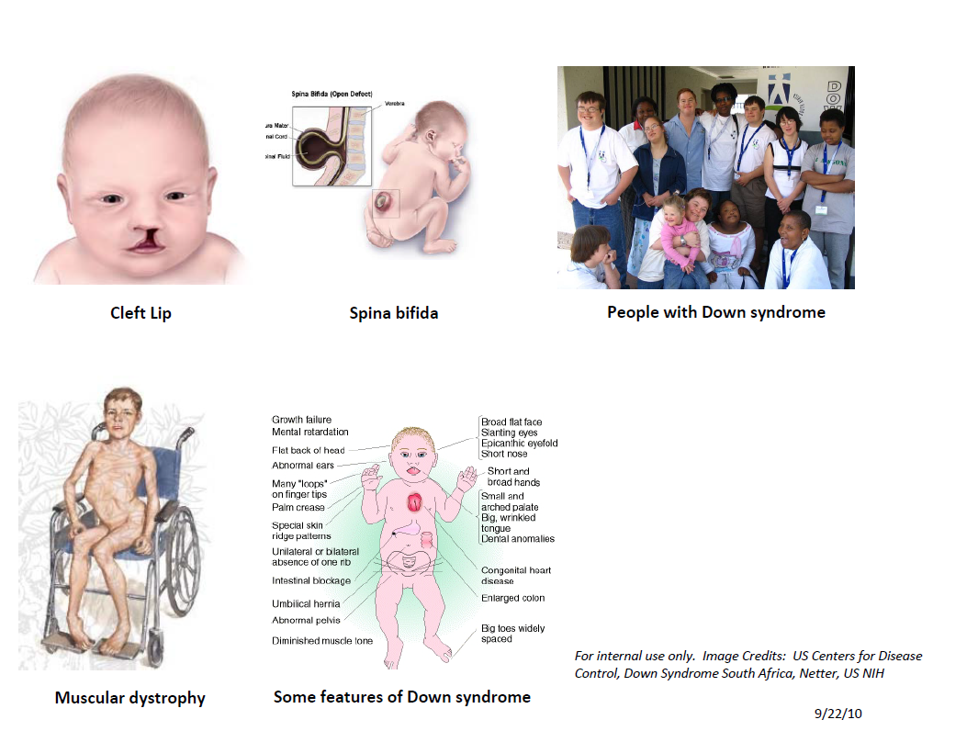
Genetic History Screening Tool
Staff may use this tool to aid in discussions with participants while in the clinic.

Slide 12
S&E Scenario 1
Abigail enrolled in ASPIRE 3 months ago, has attended study visits regularly, and today her pregnancy test returned positive for the first time.
She reports her last menses was 42 days ago.

Slide 13
S&E Scenario 1
What do you need to consider to determine if Abigail is eligible?
A participant in ASPIRE at time of conception?
YES
Confirmed pregnancy?
NO
Notes:
Pregnancy not confirmed – needs a second pregnancy test at her next ASPIRE visit or needs to reach 60 days since last menses

Slide 14
S&E Scenario 2
Maria is enrolled in MTN 020 but has missed her last 3 monthly ASPIRE visits.
Now she returns to the clinic and states she has not had menses since her last visit and thinks that she is pregnant. What are your next steps?

Slide 15
S&E Scenario 2
What are you next steps?
If ppt. is willing, perform regular ASPIRE f/u visit, including pregnancy test
If pregnancy test is positive, Maria is eligible for MTN-016 and can be enrolled immediately (since no menses for 3 months)

Slide 16
Questions?

